Slide 1

Regression: Predicting House Prices
Sruti Jain
Machine Learning Specialization
University of Washington

Slide 2

Problem Statement
Determine the housing prices of California properties for new sellers and also for buyers to estimate the profitability of the deal.
Question: How much is my house worth?
Solution: Involves looking at recent sales in the neighborhood

Slide 3
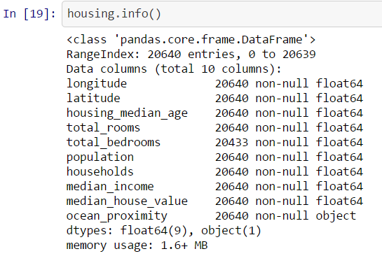
Dataset Details
The data is taken from California census data with 20,640 instances & 10 attributes
Converted the text attribute (ocean_proximity) into categorical data types using one hot encoding scheme using Scikit package.
Attributes like latitude, longitude were used during exploratory analysis. Not used in further model building.
Feature standardization was performed on all numeric data variables.
The dataset was split into Train-Validate-Test samples using Stratified sampling.

Slide 4
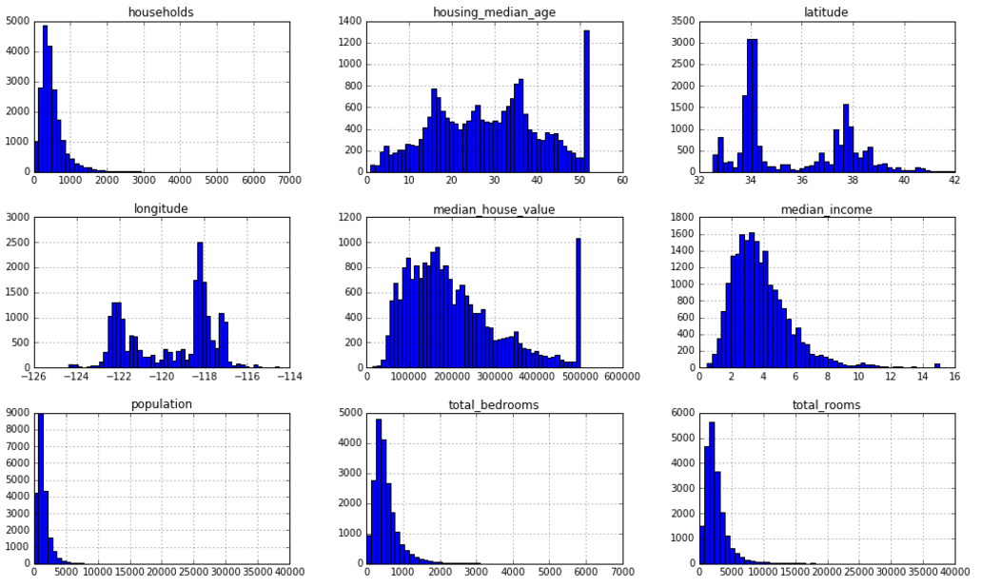
Correlation Plot

Slide 5
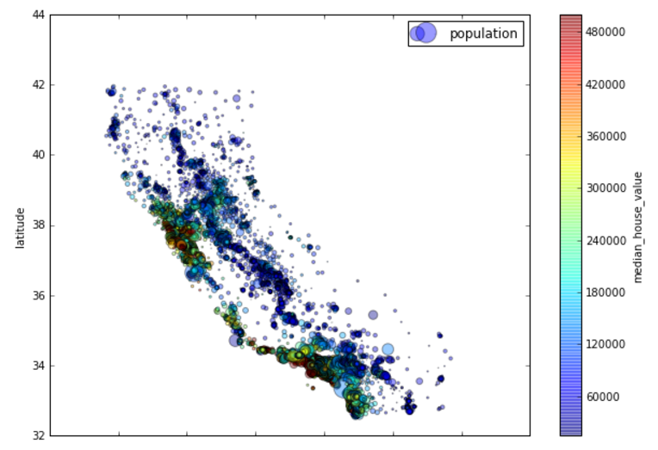
Exploratory Analysis Plot
Plot to visualize role of latitude, longitude & population on the price of the house

Slide 6
Training-Testing Models
Linear Regression
Decision Tree Regressor
Random Forest Regressor
Support Vector Regressor
Fine Tuning the Hyperparameters for Random Forest Regressor using Grid Search and Randomized Search
Note: Random seed values were picked to develop training, validation & testing sets in the ratio 60:20:20

Slide 7
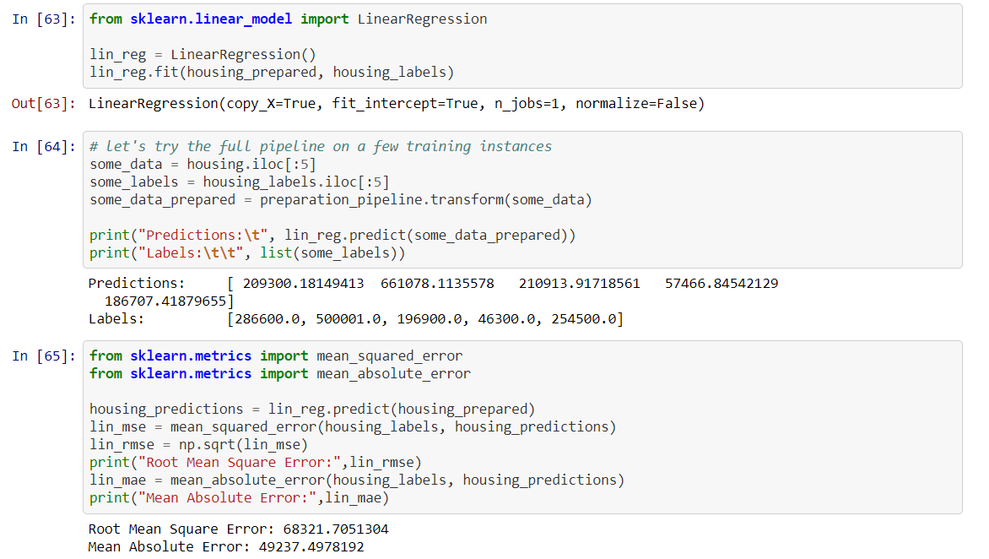
Linear Regression
Linear regression helped understand which variable are significant & which not. Also since many of our attributes are continuous, linear regression is a good approach to use as a starting step.

Slide 8
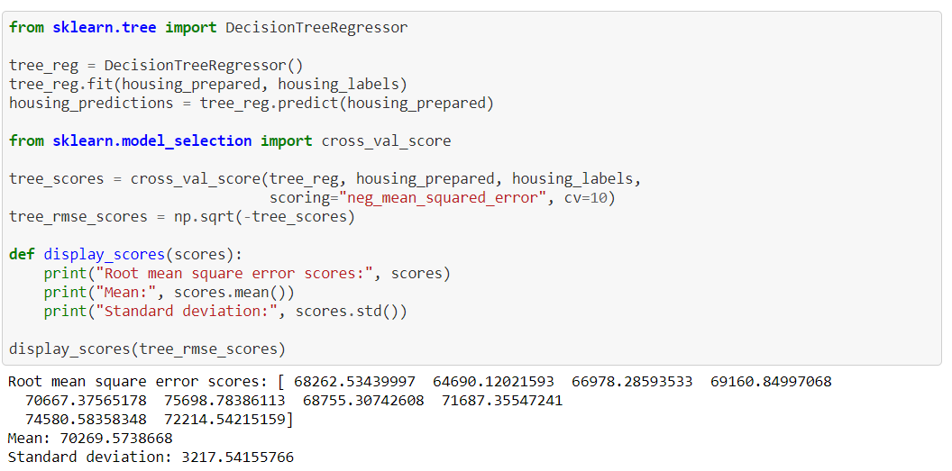
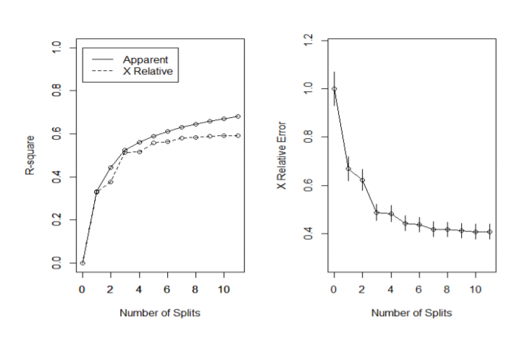
Decision Tree Regressor

Slide 9
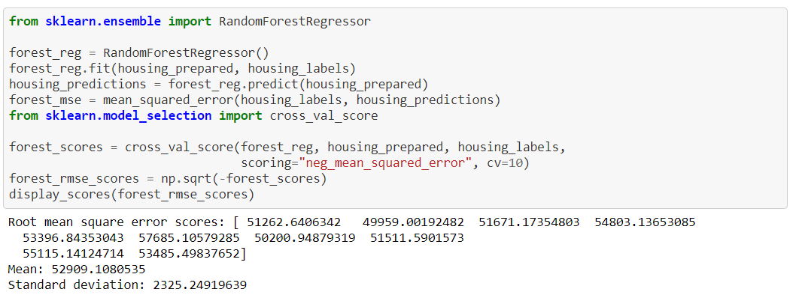
Random Forest Regressor

Slide 10
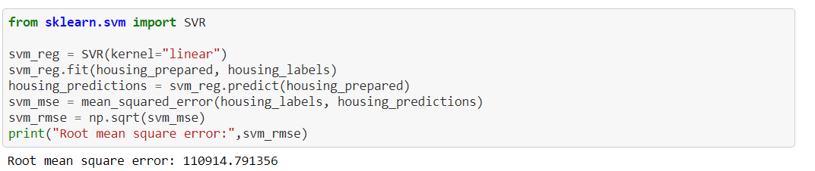
Support Vector Regressor

Slide 11
Comparative Analysis
In multiple linear regression, the best R-Squared 0.6002, correlation of prediction and test is 0.7748672 and RMSE- 68321.70.
In Decision Tree, the best regression model comes from random forest with correlation 0.876914 and RMSE- 70269.57.
In SVM model, model with linear kernel performs best with correlation 0.82014 & RMSE- 110914.79.
Of the four models, random forest performs better than the others with least RMSE- 49261.28 obtained by tuning the Hyperparameters using Randomized Search.

Slide 12
Thank You !!

